Slide 1
Multi-Task Learning(MTL) and MAXL
李晓宇
2020.4.

Slide 2
Multi-Task Learning in Deep Learning

Slide 3
MTL Overview
MTL: By sharing representations between related tasks, we can enable our model to generalize better on our original task.
Goal: MTL improves generalization by leveraging the domain-specific information contained in the training signals of related tasks
Motivation: 1. Biologically, human learning; 2. In machine learning, inductive transfer which can help improve a model by introducing an inductive bias

Slide 4
Methods – hard parameter sharing

Slide 5
Methods – soft parameter sharing

Slide 6
Methods – Deep Relation Network

Slide 7
Methods - Fully-Adaptive Feature Sharing

Slide 8
Methods - A Joint Many-Task Model

Slide 9
Methods - Cross-stitch Networks

Slide 10
Methods - Sluice Networks

Slide 11
Methods - Weighting losses with uncertainty

Slide 12
Methods - conclusion
How to share: task-shared and task-specific features
How to balance tasks

Slide 13
Auxiliary Tasks
Related task
Adversarial
Hints
Focusing attention
Quantization smoothing
Predicting inputs
Using the future to predict the present
Representation learning
Features generated by meta learning ?
Notes:
Hint : whether an input sentence contains a positive or negative sentiment word as auxiliary tasks for sentiment analysis
Quantization smoothing: predicting the risk of a disease (e.g. low/medium/high) or sentiment analysis (positive/neutral/negative). learned more easily due to their objective being smoother.

Slide 14
Self-Supervised Generalisation with Meta Auxiliary Learning

Slide 15
Overview
Problem： Learning with auxiliary tasks can improve the ability of a primary task to generalise. However, this comes at the cost of manually labelling auxiliary data.
Idea: To automatically learns appropriate labels for an auxiliary task.
Method: To train two neural networks: a label-generation network to predict the auxiliary labels, and a multi-task network to train the primary task alongside the auxiliary task. The loss for the label-generation network incorporates the loss of the multi-task network, and so this interaction between the two networks can be seen as a form of meta learning with a double gradient.

Slide 16
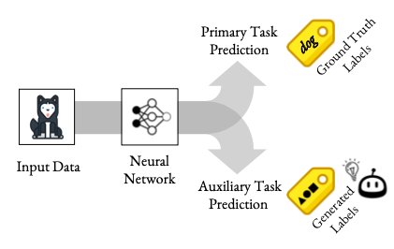
The key idea behind MAXL is to then use the performance of the primary task, when trained alongside the auxiliary task in one iteration, to improve the auxiliary labels for the next iteration. This is achieved by defining the loss for the label-generation network as a function of the multi-task network’s performance on primary task training data.

Slide 17
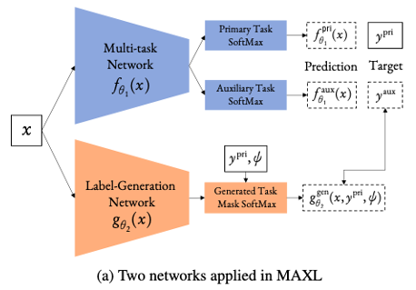

Slide 18
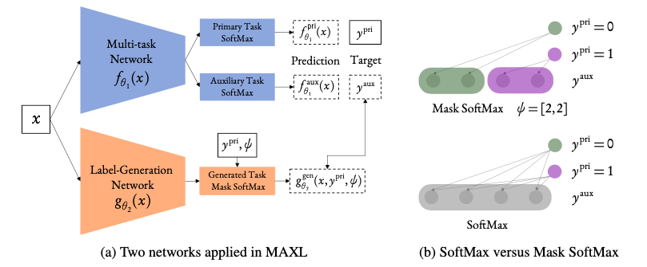
We found during experiments that training benefited from assigning each primary class its own unique set of possible auxiliary classes, rather than sharing all auxiliary classes across all primary classes.

Slide 19
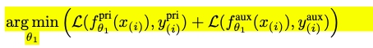
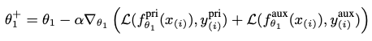
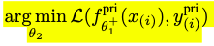
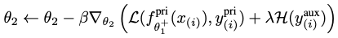
Method
To update parameters θ1 of the multi-task network
To update parameters θ2 of the label-generation network, we define the meta objective as follows
To encourage the network to learn more complex and informative auxiliary tasks, we further apply an entropy loss

Slide 20
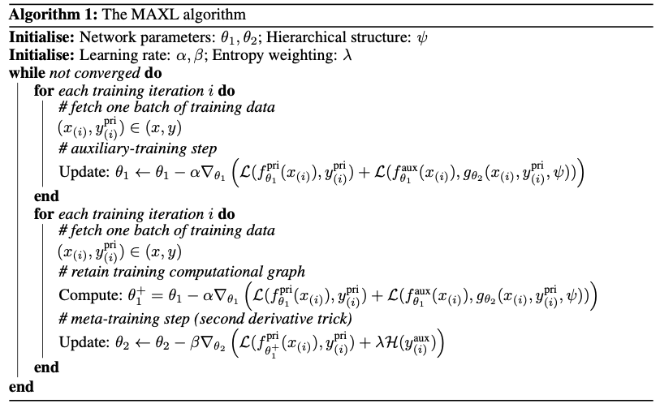
Algorithm

Slide 21
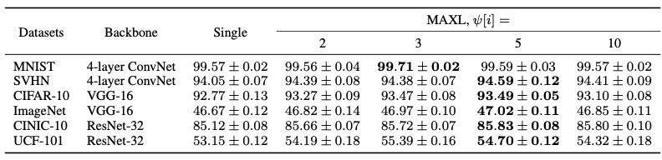
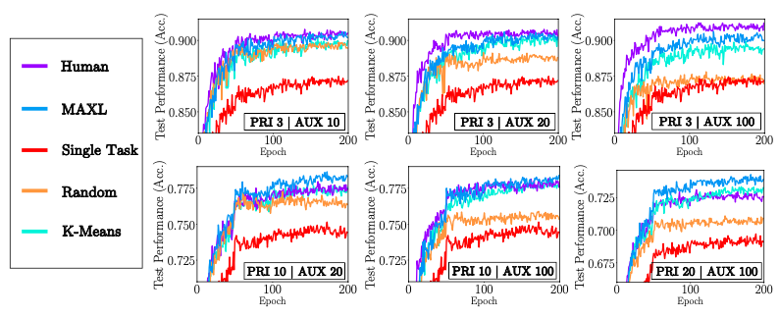

Slide 22
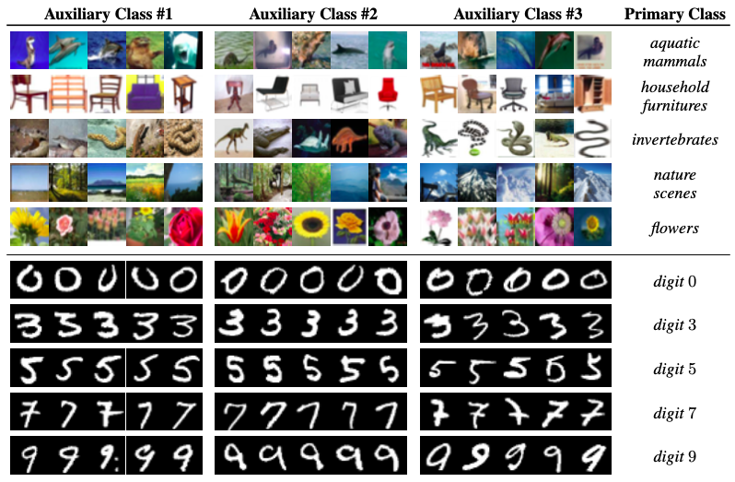
Only part of the generated auxiliary labels visualised in both dataset show human-understandable knowledge

Slide 23
Thanks & QA

